Slide 1
Thursday

Slide 2
Your Digital Footprint
Pathway
Or
Roadblock?

Slide 3
Your Digital Footprint: Pathway or Roadblock?
Many admissions committees factor in posts on social media
Your acceptance or rejection could come down to 140 characters or less
Online ID needs to complement your application packet
Some schools google students to look for red flags
THINK BEFORE YOU TWEET/POST
Be more than a blip on the radar
Like school on Facebook
Follow their Twitter Feed
Retweet & Comment on posts with insight of your own

Slide 4
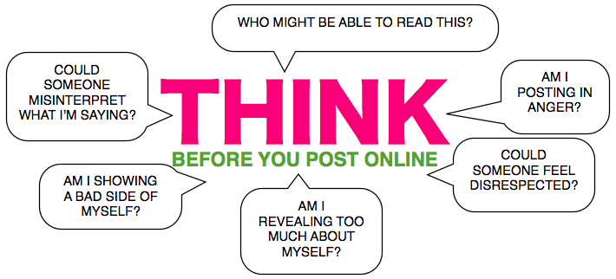

Slide 5
Have you heard what happened at Harvard?....
http://www.cnn.com/2017/06/05/us/harvard-memes/index.html
http://www.thecrimson.com/article/2017/6/5/2021-offers-rescinded-memes/

